Slide 1

tafea Teaching Assistant for Extra-curricular Activities
Group 5

Slide 2
Problem Statement
TFI fellows already handle the academic needs of large classes, making it challenging to incorporate extracurricular activities without adding to their workload. Since holistic development is crucial at the school level, providing technological support can help them conduct these activities seamlessly and without extra burden.

Slide 3
Our Solution
We have developed a platform to help TFI fellows plan and conduct extracurricular activities that foster values and skills beyond academics. The platform collects their feedback after each session, enabling iterative improvement and tracking the progress of each class or student.

Slide 4
Stakeholders
Students
TFI Fellows
School Admin
They get to acquire skills that go beyond their academics.
They can now teach extracurriculars as well, but without much extra hassle.
The progress reports of all the students as well as classes are available in one place.
Note: The TFI fellows will be the only direct users of the application.

Slide 5






Tech Stack
Chat Model
Frontend
Backend
Gemini 1.5 Flash 002
(Freely available API)
ReactJS
Tailwind CSS
NodeJS
Express
MongoDB

Slide 6
The Workflow

Slide 7
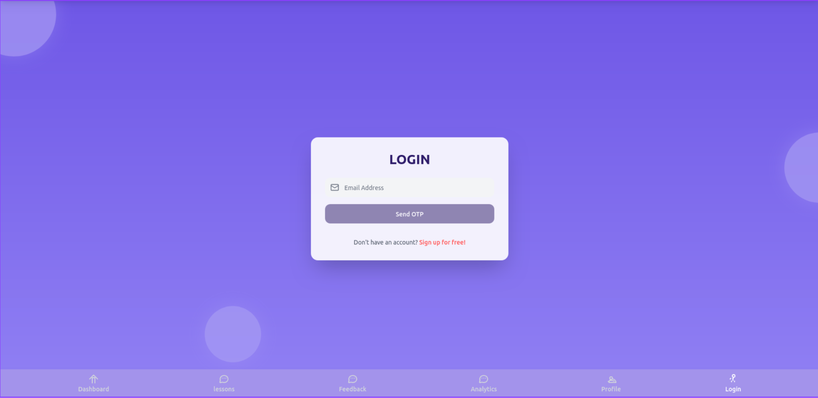
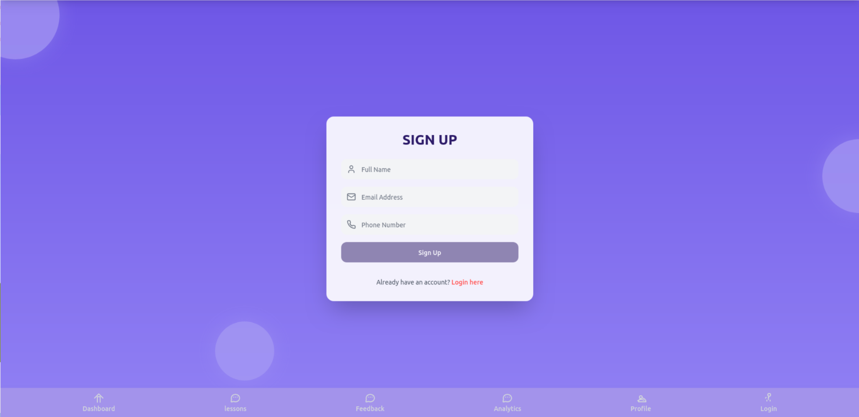
OTP-based Login

Slide 8
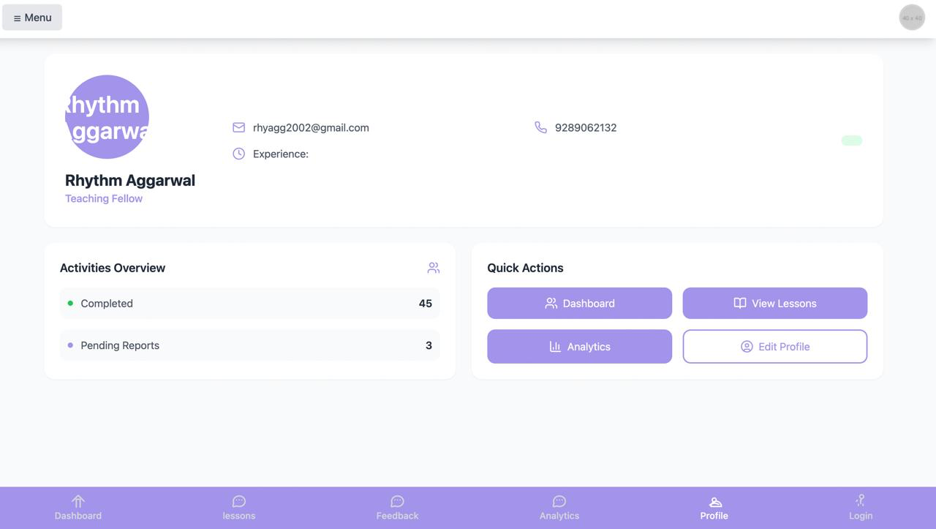
TFI Fellow Profile

Slide 9
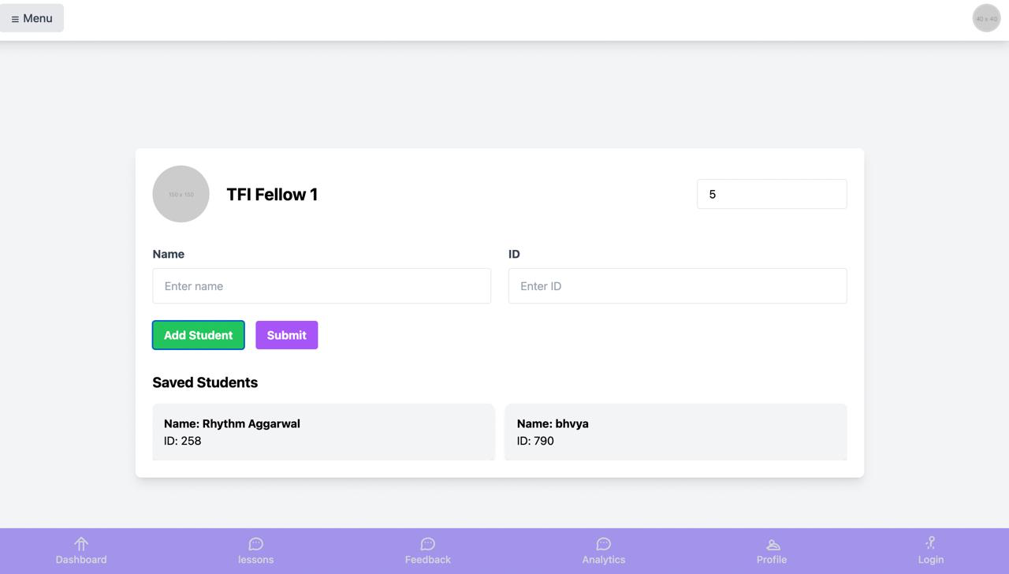
Creating a Classroom

Slide 10
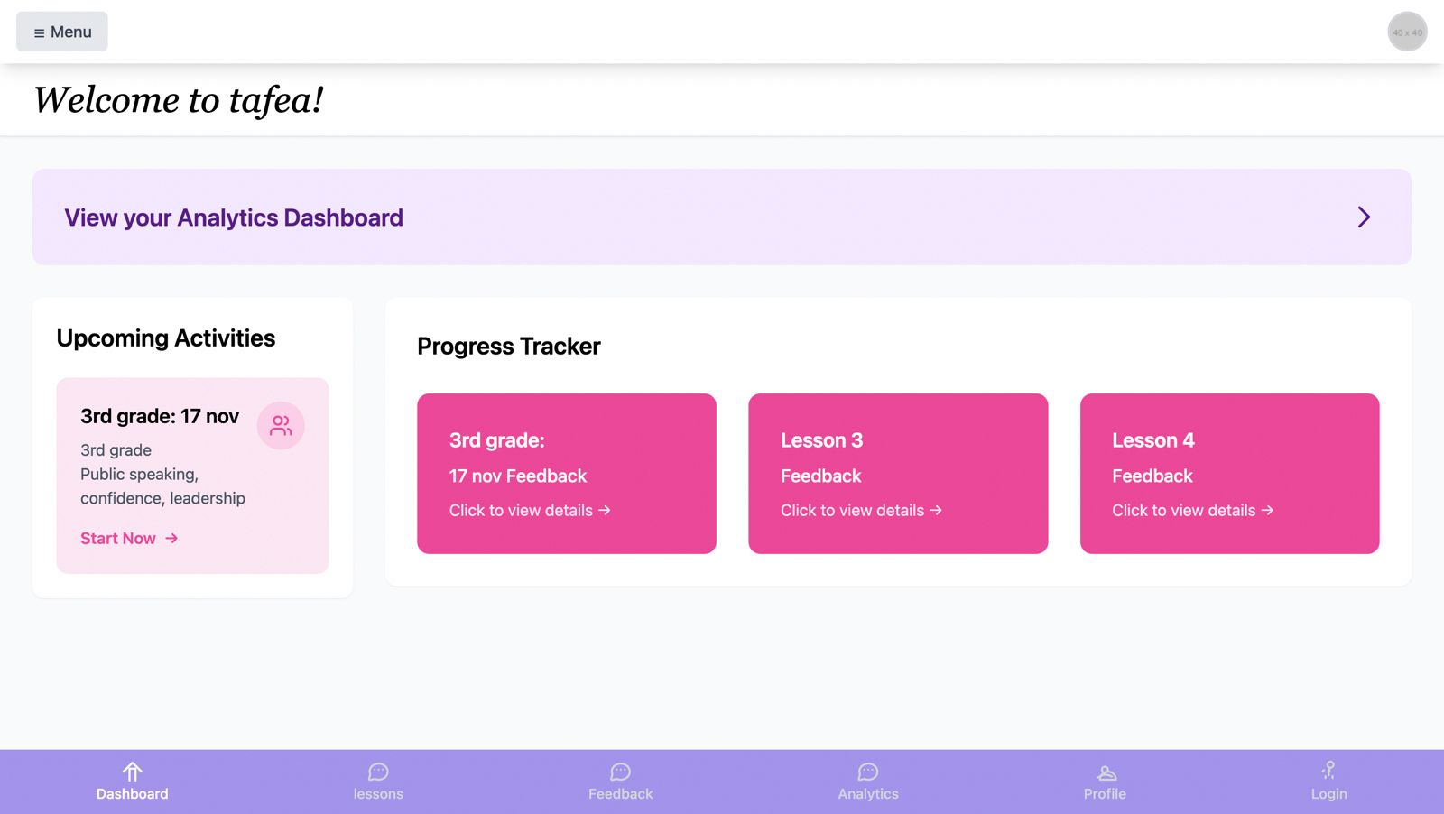
Dashboard

Slide 11
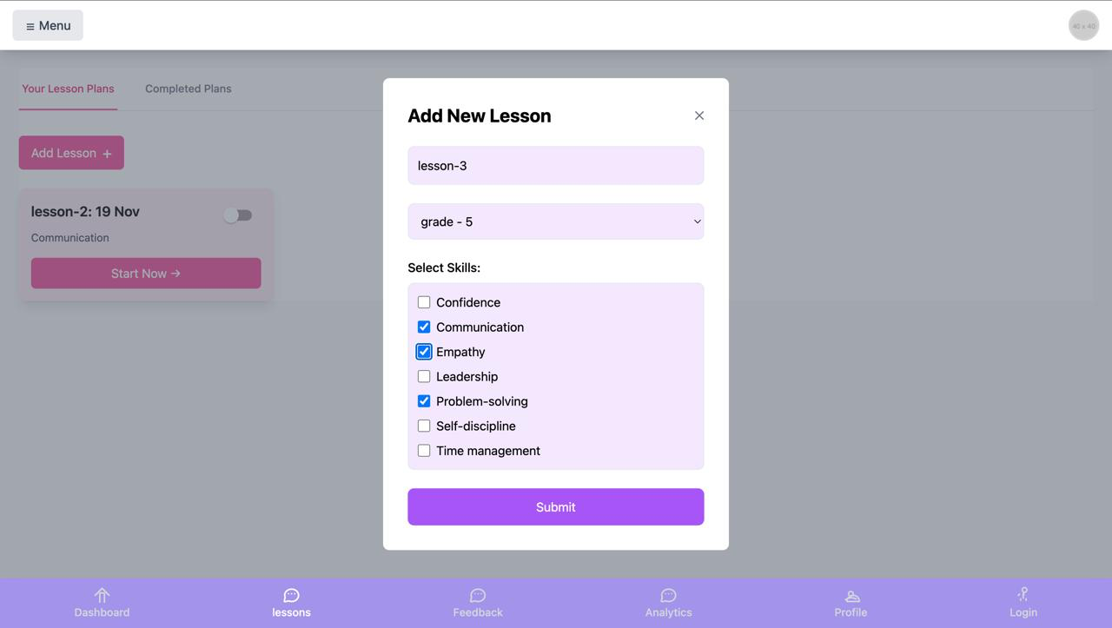
Lessons

Slide 12
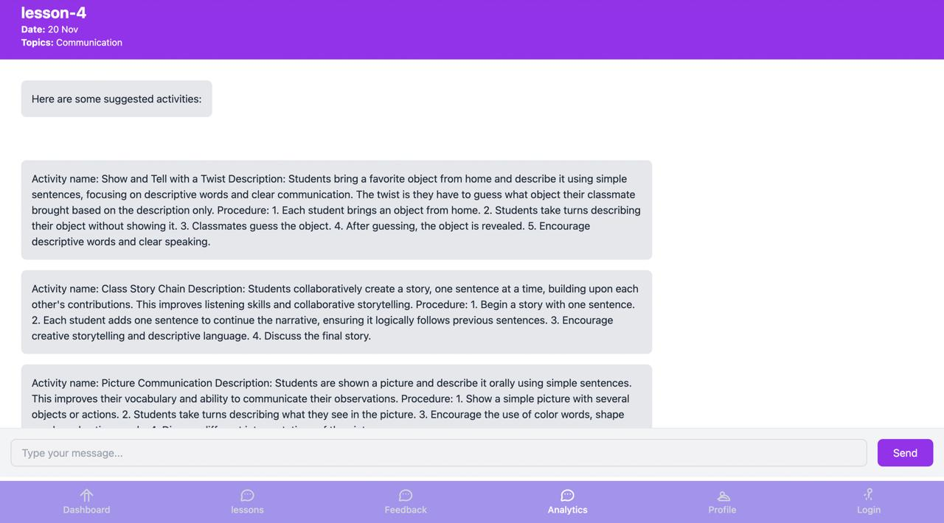
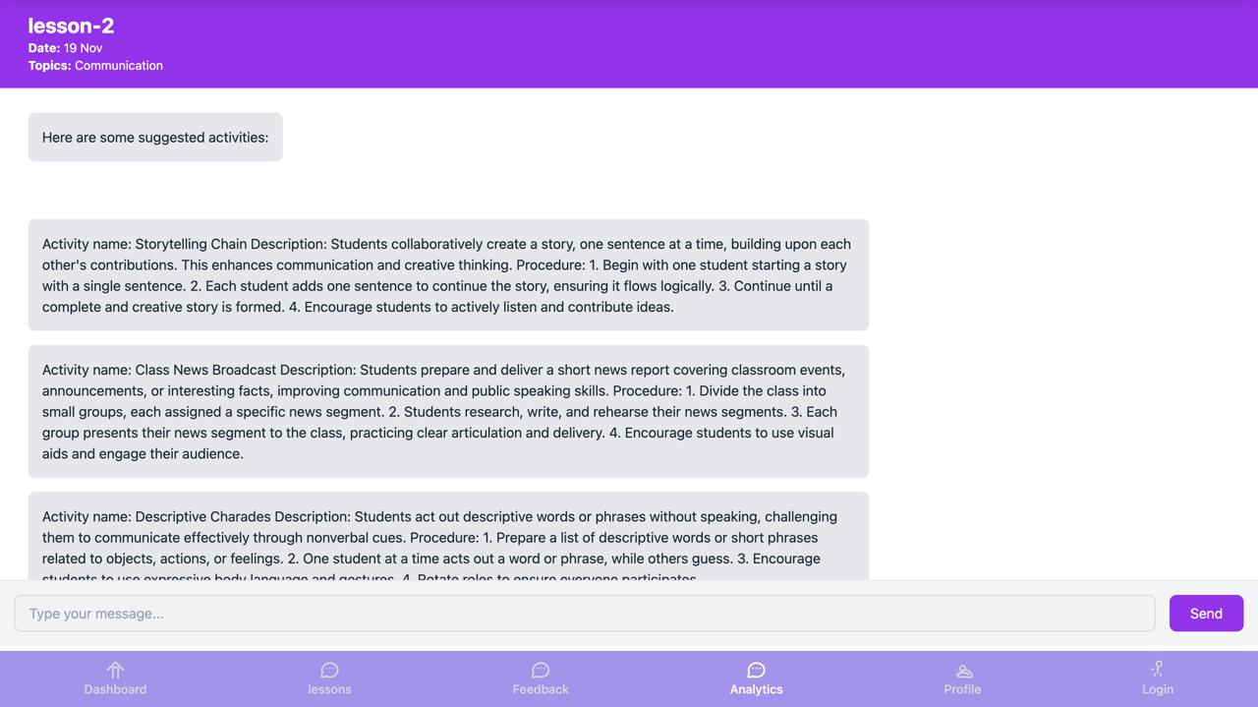
Chat for Lesson Plan generation
Grade 1
Grade 5

Slide 13
Lesson Generation Criteria
Feasibility
Structured Procedures
02
01
Inclusive Design
03
Variety & Engagement
Age-Appropriate Content
04
05
Activities are designed to be practical and easy to implement within the school setting.
Clear, step-by-step instructions for conducting each activity.
Activities are designed to be accessible and engaging for all students.
Offer a range of activity types to cater to diverse styles and interests.
Activities are tailored to the cognitive and developmental stages of the specified grade.

Slide 14
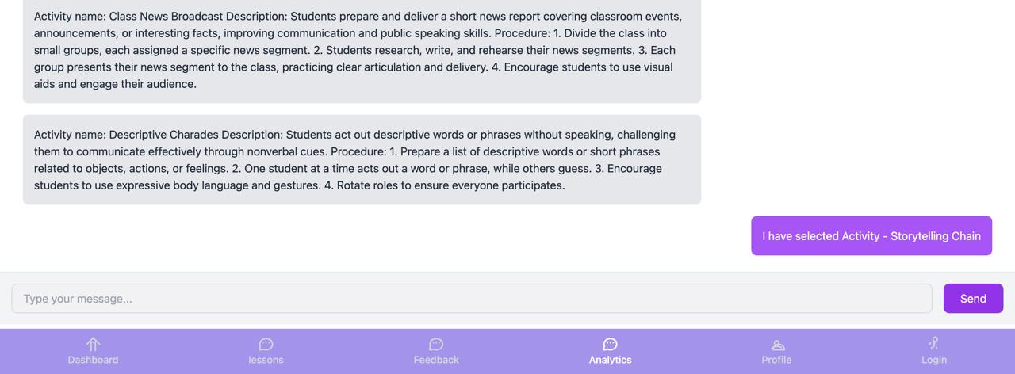
Selecting an Activity

Slide 15
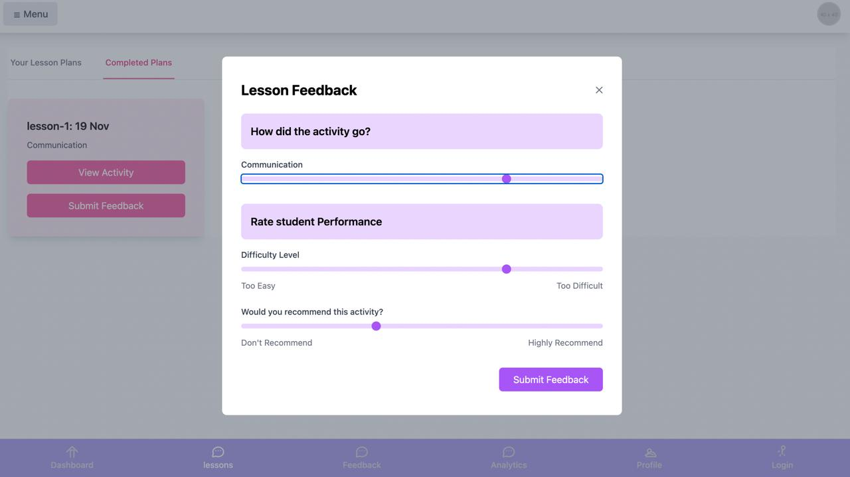
Lesson Feedback

Slide 16
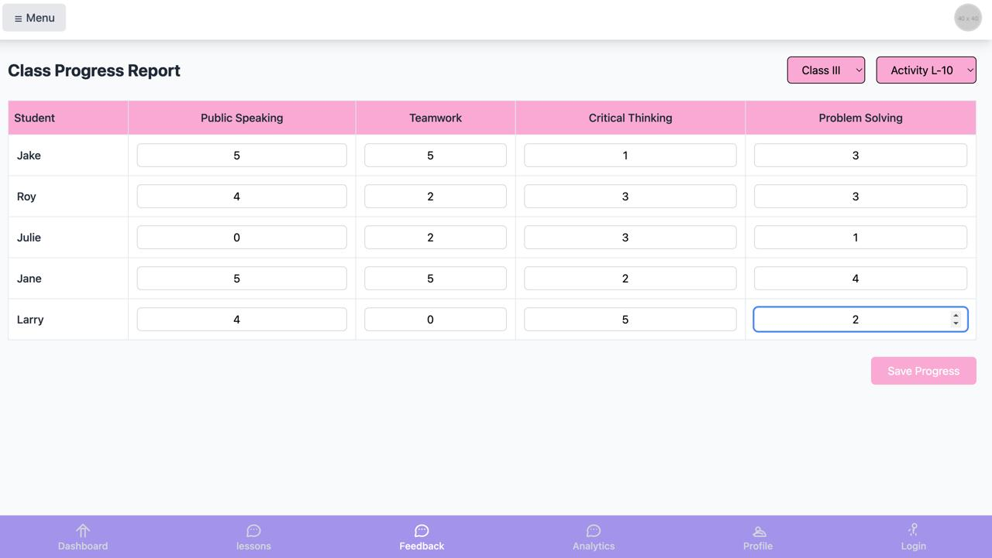
Class Progress Report

Slide 17
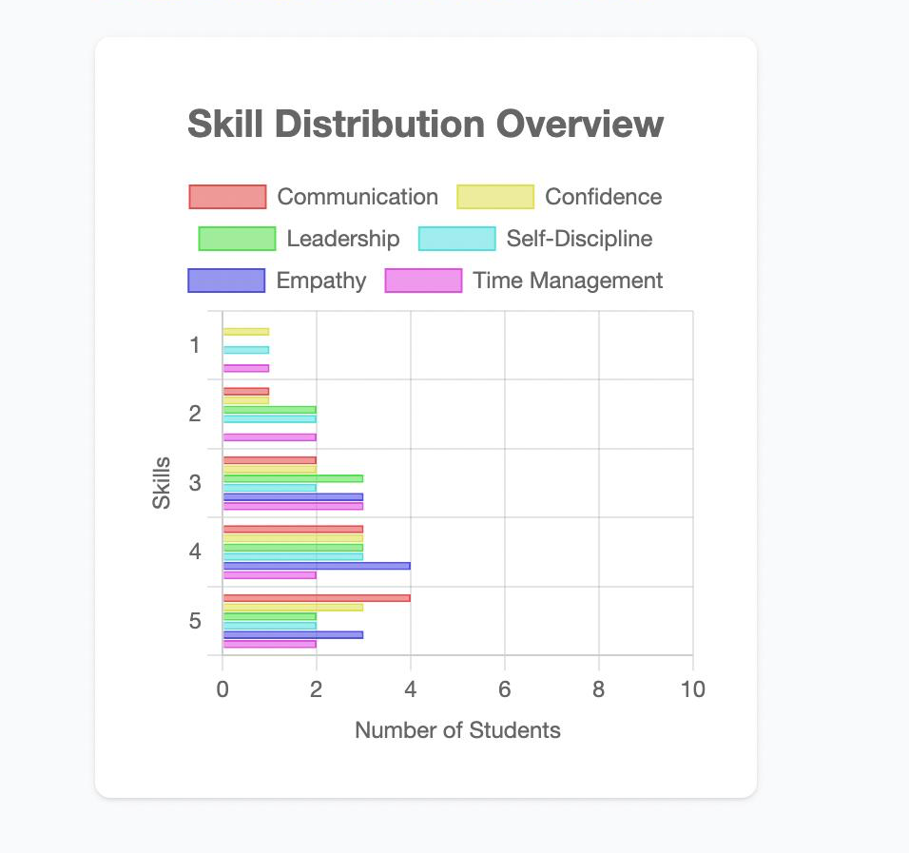
Analytics Dashboard
Month

Slide 18
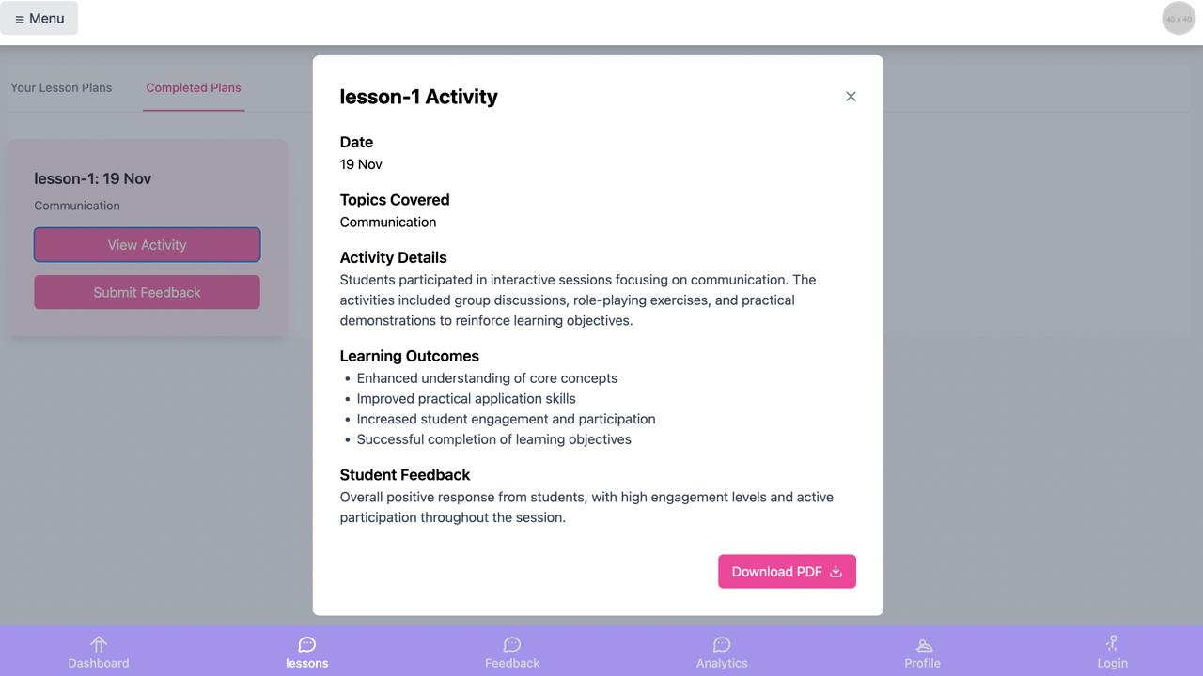
Past Lesson Overview

Slide 19
Thank you!

